Slide 1
How Did Yeast Become a Wine-Maker? Clustering Algorithms
Phillip Compeau and Pavel Pevzner
Bioinformatics Algorithms: An Active Learning Approach
©2018 by Compeau and Pevzner. All rights reserved.

Slide 2
How Did Yeast Become a Wine Maker?
Which Yeast Genes Are Responsible for Wine Brewing?
Clustering as an optimization problem
The Lloyd algorithm for k-means clustering
From Hard to Soft Clustering
From Coin Flipping to k-means Clustering
Expectation Maximization
Soft k-means Clustering
Hierarchical Clustering

Slide 3
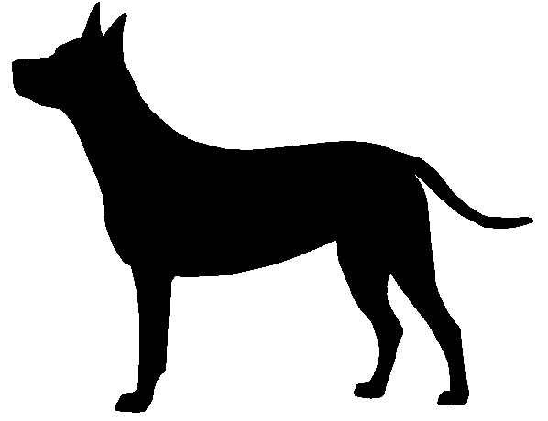
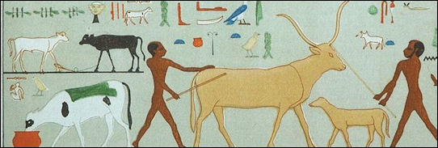
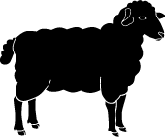
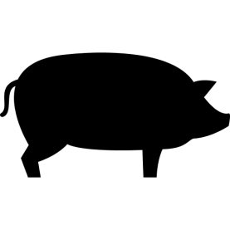
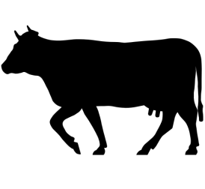
Which Domesticated Animal Is Next?
30,000 BC
10,000 BC
8,000 BC
8,000 BC
4,000 BC

Slide 4
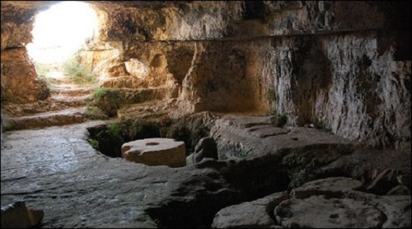
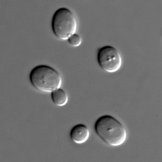
Which Domesticated Animal Is Next?
30,000 BC
10,000 BC
8,000 BC
8,000 BC
4,000 BC

Slide 5
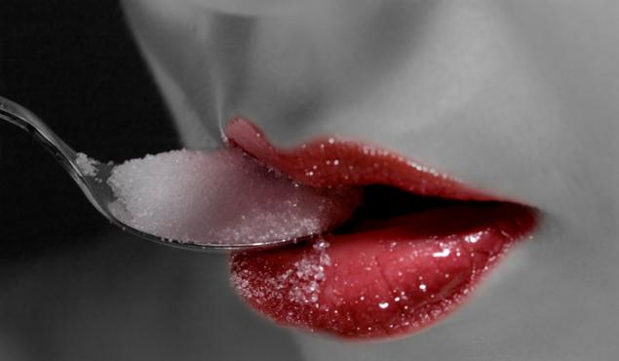
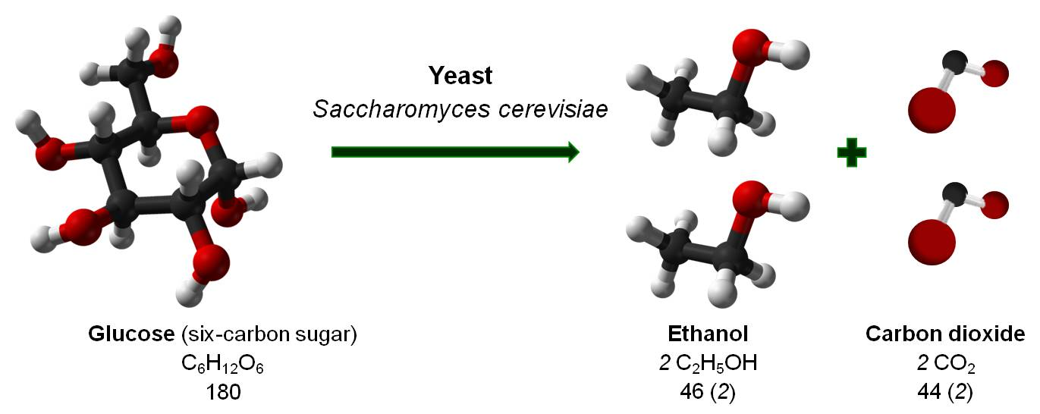
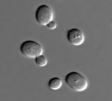

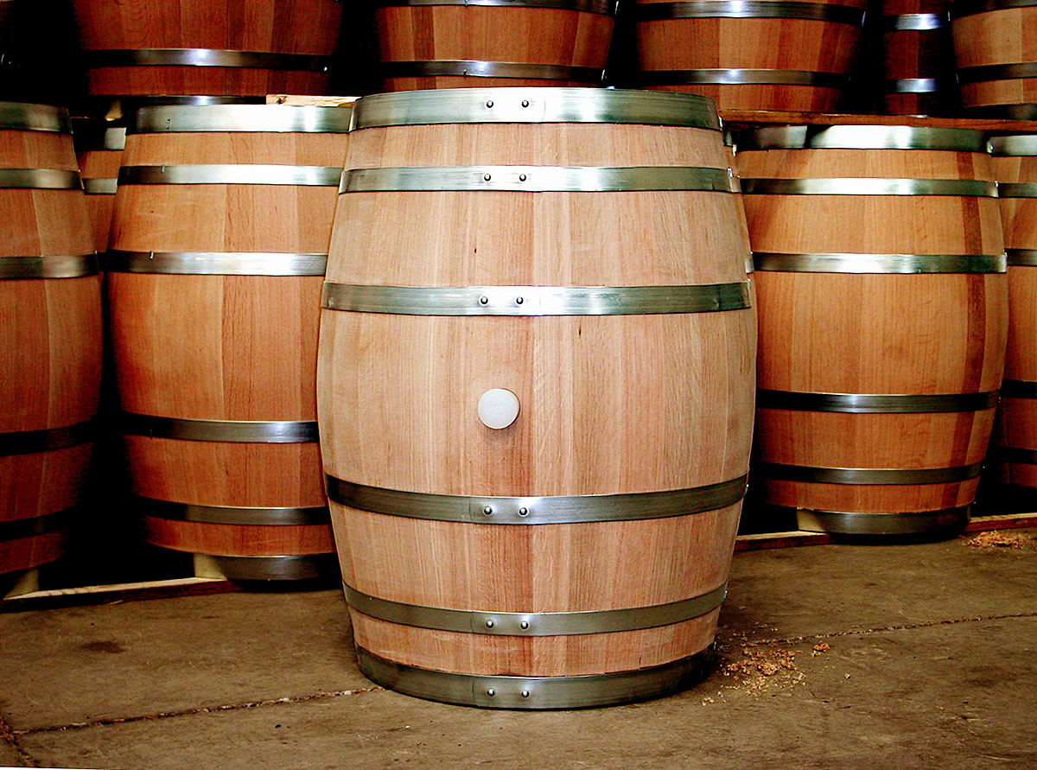
Why Do Winemakers Store Grapes in Sealed Barrels?
Yeast lives on grapevines and can convert glucose into ethanol.
glucose C₆H₁₂O₆
ethanol 2 C₂H₅OH
When the glucose runs out, yeast inverts its metabolism, and ethanol becomes its new food .
This change in metabolism (the diauxic shift) can only occur in the presence of oxygen.
Which genes are responsible for the diauxic shift?

Slide 6
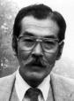


How Did Yeast Invent the Diauxic Shift?
Susumu Ohno: two hypotheses with different fates.
Random Breakage Model: genomic architectures are shaped by rearrangements that occur randomly.
was embraced by biologists until it was refuted in 2003
Whole Genome Duplication Model: Big leaps in evolution would have been impossible without whole genome duplications.
first met with skepticism but proven 30 years later

Slide 7
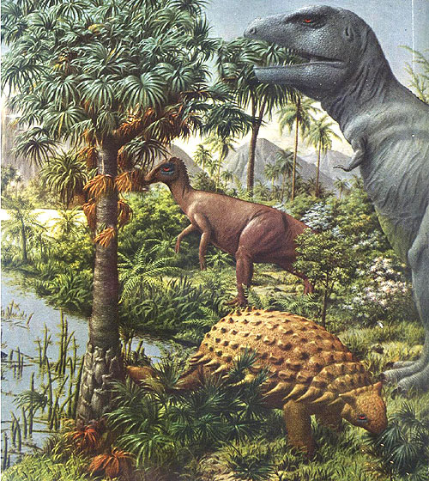
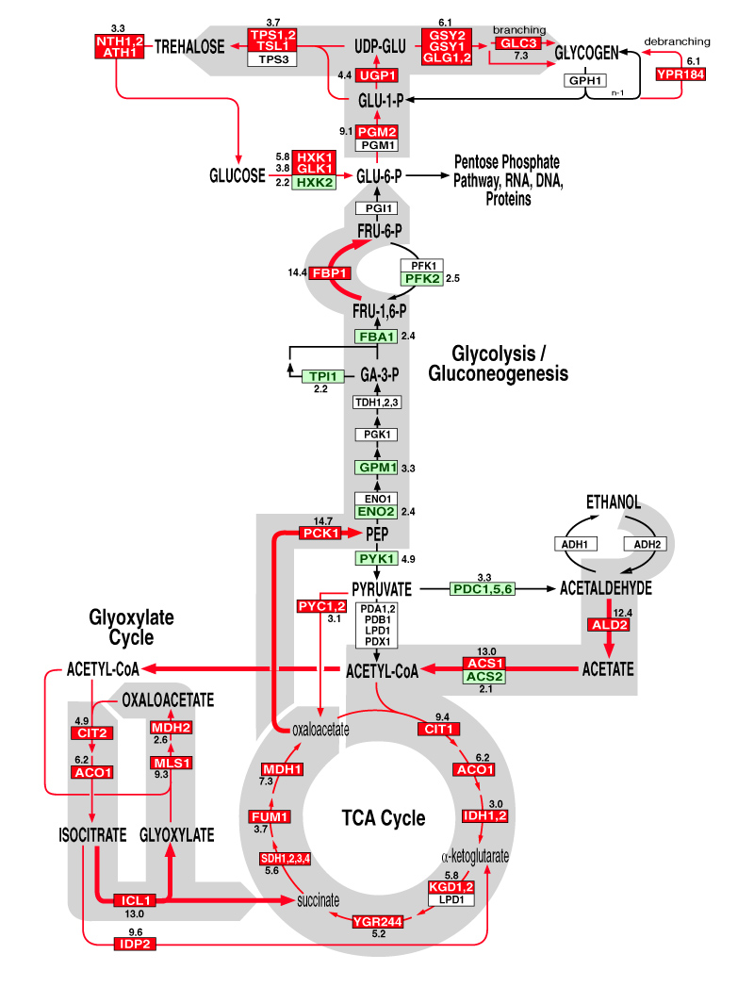
What Does It Take to Convert Glucose into Ethanol and Back?
Imagine the time when the first fruit-bearing plants evolved.
The first species to metabolize glucose would have had an enormous evolutionary advantage.
But metabolizing glucose — let alone ethanol — is not simple.
It required creating new metabolic pathways with many genes working together.

Slide 8
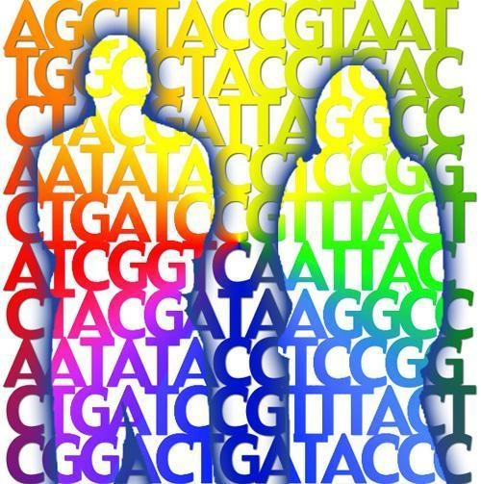
Whole Genome Duplications Enables Evolutionary Breakthroughs
Ohno argued that a WGD would provide a platform for such a revolutionary innovation, since every duplicated gene would have two copies.
One copy would be free to evolve without compromising the gene’s existing function.
Another copy would perform the existing function.

Slide 9
Measuring 3 Genes at 7 Checkpoints
Measure expression of various yeast genes at 7 checkpoints:
-6h -4h -2h 0 +2h +4h +6h
diauxic shift
YLR258W 1.1 1.4 1.4 3.7 4.0 10.0 5.9
YPL012W 1.1 0.8 0.9 0.4 0.3 0.1 0.1
YPR055W 1.1 1.1 1.1 1.1 1.1 1.1 1.1
e_{ij} = expression level of gene i at checkpoint j
10
5
2
1
0.5
0.2
0.1
10
5
2
1
0.5
0.2
0.1
10
5
2
1
0.5
0.2
0.1

Slide 10
Switching to Logarithms of Expression Levels
YLR258W 1.1 1.4 1.4 3.7 4.0 10.0 5.9
YPL012W 1.1 0.8 0.9 0.4 0.3 0.1 0.1
YPR055W 1.1 1.1 1.1 1.1 1.1 1.1 1.1
10
5
2
1
0.5
0.2
0.1
10
5
2
1
0.5
0.2
0.1
10
5
2
1
0.5
0.2
0.1
taking logarithms (base-2)
YLR258W 0.1 0.4 0.5 1.9 2.0 3.3 2.6
YPL012W 0.1 -0.3 -0.2 -1.2 -1.6 -3.0 -3.1
YPR055W 0.2 0.2 0.2 0.1 0.1 0.1 0.1

Slide 11
Gene Expression Matrix

Slide 12
Gene Expression Matrix
gene expression vector

Slide 13
Gene Expression Matrix

Slide 14
Gene Expression Matrix
1997: Joseph deRisi measured expression of 6,400 yeast genes at 7 checkpoints before and after the diauxic shift.
6,400 x 7 gene expression matrix
Goal: partition all yeast genes into clusters so that:
genes in the same cluster have similar behavior
genes in different clusters have different behavior

Slide 15
Genes as Points in Multidimensional Space
n x m gene expression matrix
(8, 7)
(1, 6)
(5, 6)
n points in m-dimensional space
(3, 4)
(1, 3)
(10, 3)
(5, 2)
(7, 1)

Slide 16
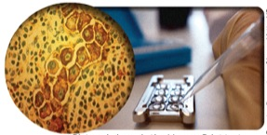
Gene Expression and Cancer Diagnostics
MammaPrint: a test that evaluates the likelihood of breast cancer recurrence based on the expression of just 70 genes.
But how did scientists discover these 70 human genes?

Slide 17
How Did Yeast Become a Wine Maker?
Which Yeast Genes Are Responsible for Wine Brewing?
Clustering as an optimization problem
The Lloyd algorithm for k-means clustering
From Hard to Soft Clustering
From Coin Flipping to k-means Clustering
Expectation Maximization
Soft k-means Clustering
Hierarchical Clustering

Slide 18
Toward a Computational Problem
Good Clustering Principle: Elements within the same cluster are closer to each other than elements in different clusters.

Slide 19
Toward a Computational Problem
distance between elements in the same cluster < ∆
distance between elements in different clusters > ∆

Slide 20
Clustering Problem
Clustering Problem: Partition a set of expression vectors into clusters.
Input: A collection of n vectors and an integer k.
Output: Partition of n vectors into k disjoint clusters satisfying the Good Clustering Principle.
Any partition into two clusters does not satisfy the Good Clustering Principle!

Slide 21
STOP and Think: What is the “best” partition into three clusters?

Slide 22
Clustering as Finding Centers
Goal: partition a set Data into k clusters.

Slide 23
Clustering as Finding Centers
Goal: partition a set Data into k clusters.
Equivalent goal: find a set of k points Centers that will serve as the “centers” of the k clusters in Data.

Slide 24
Clustering as Finding Centers
Goal: partition a set Data into k clusters.
Equivalent goal: find a set of k points Centers that will serve as the “centers” of the k clusters in Data and will minimize some notion of distance from Centers to Data .
What is the “distance” from Centers to Data?

Slide 25
Distance from a Single DataPoint to Centers
The distance from DataPoint in Data to Centers is the distance from DataPoint to the closest center:
d(DataPoint, Centers) = min_{all points x from Centers} d(DataPoint, x)

Slide 26
Distance from Data to Centers
MaxDistance(Data, Centers) =
max _{all points DataPoint from Data} d(DataPoint, Centers)

Slide 27
k-Center Clustering Problem
k-Center Clustering Problem. Given a set of points Data, find k centers minimizing MaxDistance(Data, Centers).
Input: A set of points Data and an integer k.
Output: A set of k points Centers that minimizes MaxDistance(DataPoints, Centers) over all possible choices of Centers.

Slide 28
k-Center Clustering Problem
k-Center Clustering Problem. Given a set of points Data, find k centers minimizing MaxDistance(Data, Centers).
Input: A set of points Data and an integer k.
Output: A set of k points Centers that minimizes MaxDistance(DataPoints, Centers) over all possible choices of Centers.

Slide 29

k-Center Clustering Problem
k-Center Clustering Problem. Given a set of points Data, find k centers minimizing MaxDistance(Data, Centers).
Input: A set of points Data and an integer k.
Output: A set of k points Centers that minimizes MaxDistance(DataPoints, Centers) over all possible choices of Centers.
An even better set of centers!

Slide 30
k-Center Clustering Heuristic
FarthestFirstTraversal(Data, k)
Centers ← the set consisting of a single DataPoint from Data
while Centers have fewer than k points
DataPoint ← a point in Data maximizing d(DataPoint, Centers) among all data points
add DataPoint to Centers

Slide 31
k-Center Clustering Heuristic
FarthestFirstTraversal(Data, k)
Centers ← the set consisting of a single DataPoint from Data
while Centers have fewer than k points
DataPoint ← a point in Data maximizing d(DataPoint, Centers) among all data points
add DataPoint to Centers

Slide 32
k-Center Clustering Heuristic
FarthestFirstTraversal(Data, k)
Centers ← the set consisting of a single DataPoint from Data
while Centers have fewer than k points
DataPoint ← a point in Data maximizing d(DataPoint, Centers) among all data points
add DataPoint to Centers

Slide 33
What Is Wrong with FarthestFirstTraversal?
FarthestFirstTraversal selects Centers that minimize MaxDistance(Data, Centers).
But biologists are interested in typical rather than maximum deviations, since maximum deviations may represent outliers (experimental errors).
human eye
FarthestFirstTraversal

Slide 34
Modifying the Objective Function
The maximal distance between Data and Centers:
MaxDistance(Data, Centers)=
max _{DataPoint from Data} d(DataPoint, Centers)
The squared error distortion between Data and Centers:
Distortion(Data, Centers) =
∑ _{DataPoint from Data} d(DataPoint, Centers)²/n
A single data point contributes to MaxDistance
All data points contribute to Distortion

Slide 35
k-Means Clustering Problem
k-Center Clustering Problem:
Input: A set of points Data and an integer k.
Output: A set of k points Centers that minimizes
MaxDistance(DataPoints,Centers)
over all choices of Centers.
k-Means Clustering Problem:
Input: A set of points Data and an integer k.
Output: A set of k points Centers that minimizes
Distortion(Data,Centers)
over all choices of Centers.

Slide 36
k-Means Clustering Problem
k-Center Clustering Problem:
Input: A set of points Data and an integer k.
Output: A set of k points Centers that minimizes
MaxDistance(DataPoints,Centers)
over all choices of Centers.
k-Means Clustering Problem:
Input: A set of points Data and an integer k.
Output: A set of k points Centers that minimizes
Distortion(Data,Centers)
over all choices of Centers.

Slide 37
k-Means Clustering Problem
k-Center Clustering Problem:
Input: A set of points Data and an integer k.
Output: A set of k points Centers that minimizes
MaxDistance(DataPoints,Centers)
over all choices of Centers.
k-Means Clustering Problem:
Input: A set of points Data and an integer k.
Output: A set of k points Centers that minimizes
Distortion(Data,Centers)
over all choices of Centers.
NP-Hard for k > 1

Slide 38
k-Means Clustering for k = 1
Center of Gravity Theorem: The center of gravity of points Data is the only point solving the 1-Means Clustering Problem.
The center of gravity of points Data is
∑_{all points DataPoint in Data} DataPoint / #points in Data
5
3
1
i-th coordinate of the center of gravity = the average of the i-th coordinates of datapoints:
((2+4+6)/3, (3+1+5)/3 ) = (4, 3)
2 4 6

Slide 39
How Did Yeast Become a Wine Maker?
Which Yeast Genes Are Responsible for Wine Brewing?
Clustering as an optimization problem
The Lloyd algorithm for k-means clustering
From Hard to Soft Clustering
From Coin Flipping to k-means Clustering
Expectation Maximization
Soft k-means Clustering
Hierarchical Clustering

Slide 40
The Lloyd Algorithm in Action

Slide 41
The Lloyd Algorithm in Action
Select k arbitrary data points as Centers

Slide 42
The Lloyd Algorithm in Action
Clusters
Centers
assign each data point to its nearest center

Slide 43
The Lloyd Algorithm in Action
Clusters
Centers
new centers ⬅ clusters’ centers of gravity

Slide 44
The Lloyd Algorithm in Action
STOP and Think: What do we do now?

Slide 45
The Lloyd Algorithm in Action
Clusters
again!
Centers
assign each data point to its nearest center

Slide 46
The Lloyd Algorithm in Action
Clusters
again!
Centers
new centers ⬅ clusters’ centers of gravity

Slide 47
The Lloyd Algorithm in Action
Clusters
again!
Centers
assign each data point to its nearest center

Slide 48
Lloyd Algorithm
Select k arbitrary data points as Centers and then iteratively perform the following steps:
Centers to Clusters: Assign each data point to the cluster corresponding to its nearest center (ties are broken arbitrarily).
Clusters to Centers: After the assignment of data points to k clusters, compute new centers as clusters’ center of gravity.

Slide 49
The Lloyd Algorithm
Select k arbitrary data points as Centers and then iteratively performs the following two steps:
Centers to Clusters: Assign each data point to the cluster corresponding to its nearest center (ties are broken arbitrarily).
Clusters to Centers: After the assignment of data points to k clusters, compute new centers as clusters’ center of gravity.
The Lloyd algorithm terminates when the centers stop moving (convergence).

Slide 50
Must the Lloyd Algorithm Converge?
If a data point is assigned to a new center during the Centers to Clusters step:
the squared error distortion is reduced because this center must be closer to the point than the previous center was.

Slide 51
Must the Lloyd Algorithm Converge?
If a data point is assigned to a new center during the Centers to Clusters step:
the squared error distortion is reduced because this center must be closer to the point than the previous center was.
If a center is moved during the Clusters to Centers step:
the squared error distortion is reduced since the center of gravity is the only point minimizing the distortion (the Center of Gravity Theorem).

Slide 52
Clustering Yeast Genes
Cluster 1
Cluster 2
Cluster 3
4
4
4
2
2
2
0
0
0
-2
-2
-2
-4
-4
-4
Cluster 4
Cluster 5
Cluster 6
4
4
4
2
2
2
0
0
0
-2
-2
-2
-4
-4
-4

Slide 53
Clustering Yeast Genes
Cluster 1
Cluster 2
Cluster 3
4
4
4
2
2
2
0
0
0
-2
-2
-2
-4
-4
-4
Cluster 4
Cluster 5
Cluster 6
4
4
4
2
2
2
0
0
0
-2
-2
-2
-4
-4
-4

Slide 54
k-means Clustering vs. the Human Eye
STOP and Think: How would you cluster these three sets of points?

Slide 55
k-means Clustering vs. the Human Eye
STOP and Think: How would the Lloyd algorithm cluster these sets of points?

Slide 56
How Did Yeast Become a Wine Maker?
Which Yeast Genes Are Responsible for Wine Brewing?
Clustering as an optimization problem
The Lloyd algorithm for k-means clustering
From Hard to Soft Clustering
From Coin Flipping to k-means Clustering
Expectation Maximization
Soft k-means Clustering
Hierarchical Clustering

Slide 57
Soft vs. Hard Clustering
Midpoint: A point approximately halfway between two clusters.

Slide 58
Soft vs. Hard Clustering
The Lloyd algorithm assigns the midpoint either to the red or to the blue cluster.
“hard” assignment of data points to clusters.
Can we color the midpoint half-red and half-blue?
“soft” assignment of data points to clusters.

Slide 59
Soft vs. Hard Clustering
The Lloyd algorithm assigns the midpoint either to the red or to the blue cluster.
“hard” assignment of data points to clusters.
Can we color the midpoint half-red and half-blue?
“soft” assignment of data points to clusters.

Slide 60
Soft vs. Hard Clustering
(0.98, 0.02)
(0.01, 0.99)
(0.48, 0.52)
Hard choices: points are colored red or blue depending on their cluster membership.
Soft choices: points are assigned “red” and “blue” responsibilities r_{blue} and r_{red} (r_{blue} + r_{red} =1)

Slide 61
How Did Yeast Become a Wine Maker?
Which Yeast Genes Are Responsible for Wine Brewing?
Clustering as an optimization problem
The Lloyd algorithm for k-means clustering
From Hard to Soft Clustering
From Coin Flipping to k-means Clustering
Expectation Maximization
Soft k-means Clustering
Hierarchical Clustering

Slide 62
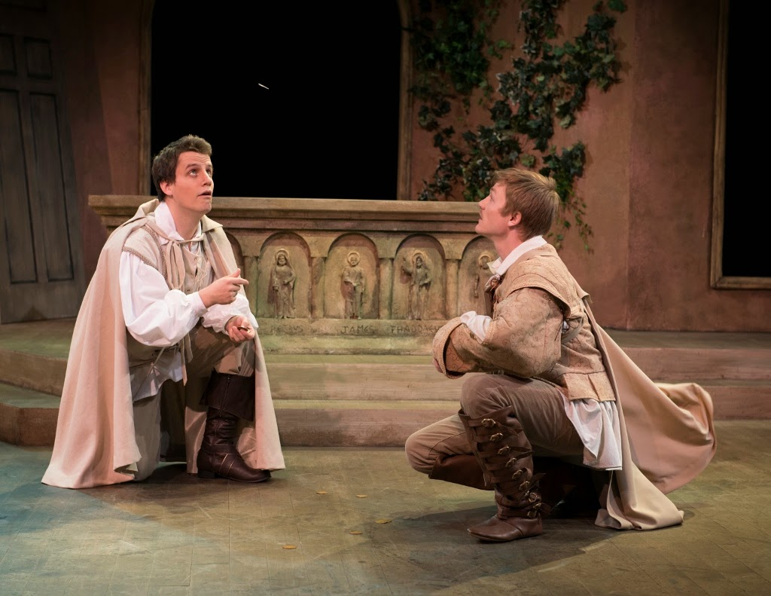
Rosencrantz and Guildenstern Flip a Coin

Slide 63
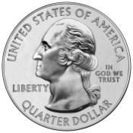
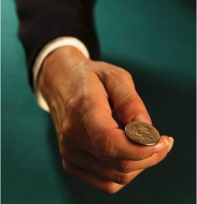
Flipping One Biased Coins
We flip a loaded coin with an unknown biasθ (probability that the coin lands on heads).
The coin lands on heads i out of n times.
For each bias, we can compute the probability of the resulting sequence of flips.
Probability of generating the given sequence of flips is
Pr(sequence|θ) = θ^{i} * (1-θ)^{n-i}
This expression is minimized atθ= i/n (most likely bias)

Slide 64
Flipping Two Biased Coins
A B
Data
HTTTHTTHTH 0.4
HHHHTHHHHH 0.9
HTHHHHHTHH 0.8
HTTTTTHHTT 0.3
THHHTHHHTH 0.7
Goal: estimate the probabilitiesθ_{A} andθ_{B}

Slide 65
If We Knew Which Coin Was Used in Each Sequence…
Data HiddenVector
HTTTHTTHTH 0.4 1
HHHHTHHHHH 0.9 0
HTHHHHHTHH 0.8 0
HTTTTTHHTT 0.3 1
THHHTHHHTH 0.7 0
Goal: estimate Parameters = (θ_{A} ,θ_{B})
when HiddenVector is given

Slide 66
If We Knew Which Coin Was Used in Each Sequence…
Data HiddenVector
HTTTHTTHTH 0.4 1
HHHHTHHHHH 0.9 0
HTHHHHHTHH 0.8 0
HTTTTTHHTT 0.3 1
THHHTHHHTH 0.7 0
θ_{A} = fraction of heads generated in all flips with coin A =
(4+3) / (10+10) = (0.4+0.3) / 2 = 0.35

Slide 67
If We Knew Which Coin Was Used in Each Sequence…
Data HiddenVector
HTTTHTTHTH 0.4 1
HHHHTHHHHH 0.9 0
HTHHHHHTHH 0.8 0
HTTTTTHHTT 0.3 1
THHHTHHHTH 0.7 0
θ_{A} = fraction of heads generated in all flips with coin A =
(4+3) / (10+10) = (0.4+0.3) / 2 = 0.35
θ_{B} = fraction of heads generated in all flips with coin B =
(9+8+7) / (10+10+10) = (0.9+0.8+0.7) / (1+1+1) = 0.80

Slide 68
Parameters as a Dot-Product
Data HiddenVector Parameters=(θ_{A,} θ_{B})
HTTTHTTHTH 0.4 1
HHHHTHHHHH 0.9 0
HTHHHHHTHH 0.8 0 (0.35, 0.80)
HTTTTTHHTT 0.3 1
THHHTHHHTH 0.7 0
*
*
*
*
*
θ_{A} = fraction of heads generated in all flips with coin A =
= (4+3) / (10+10) = (0.4+0.3) / 2 = 0.35
(0.4*1+0.9*0+0.8*0+0.3*1+0.7*0)/ (1+0+0+1+0) = 0.35
∑_{all data points i} Data_{i}*HiddenVector_{i} / ∑_{all data points i}HiddenVector_{i}= 0.35
Data * HiddenVector /
1 * HiddenVector
(1,1,…, 1)*HiddenVector =0.35
1 refers to a vector (1,1, … ,1) consisting of all 1s

Slide 69
Parameters as a Dot-Product
Data HiddenVector Parameters=(θ_{A,} θ_{B})
HTTTHTTHTH 0.4 1
HHHHTHHHHH 0.9 0
HTHHHHHTHH 0.8 0 (0.35, 0.80)
HTTTTTHHTT 0.3 1
THHHTHHHTH 0.7 0
*
*
*
*
*
θ_{B} = fraction of heads generated in all flips with coin B = (9+8+7) / (10+10+10) = (0.9+0.8+0.7) /( 1+1+1) = 0.80
(0.5*0+0.9*1+0.8*1+0.4*0+0.7*1) / (0+1+1+0+1) = 0.80
∑_{all points i} Data_{i} * (1- HiddenVector_{i}) / ∑ _{all points i} (1- HiddenVector_{i})=
Data * (1-HiddenVector) /
1 * (1 - HiddenVector)

Slide 70
Parameters as a Dot-Product
Data HiddenVector Parameters=(θ_{A,} θ_{B})
HTTTHTTHTH 0.4 1
HHHHTHHHHH 0.9 0
HTHHHHHTHH 0.8 0 (0.35, 0.80)
HTTTTTHHTT 0.3 1
THHHTHHHTH 0.7 0
*
*
*
*
*
θ_{A} = fraction of heads generated in all flips with coin A = (0.4+0.3)/2=0.35
= Data * HiddenVector / 1 * HiddenVector
θ_{B} = fraction of heads generated in all flips with coin B = (0.9+0.8+0.7)/3=0.80
= Data * (1-HiddenVector) / 1 * (1 - HiddenVector)

Slide 71
Data, HiddenVector, Parameters
Data HiddenVector Parameters=(θ_{A}, θ_{B})
0.4 1
0.9 0
0.8 0 (0.35, 0.80)
0.3 1
0.7 0
HiddenVector
Parameters

Slide 72
Data, HiddenVector, Parameters
Data HiddenVector Parameters=(θ_{A}, θ_{B})
0.4 ?
0.9 ?
0.8 ? (0.35, 0.80)
0.3 ?
0.7 ?
?
HiddenVector
Parameters

Slide 73
From Data & Parameters to HiddenVector
Data HiddenVector Parameters=(θ_{A}, θ_{B})
0.4 ?
0.9 ?
0.8 ? (0.35, 0.80)
0.3 ?
0.7 ?
STOP and Think: Which coin is more likely to generate the 1st sequence (with 4 H)?
Pr(1st sequence|θ_{A})=θ_{A}⁴ (1-θ_{A})⁶ = 0.35⁴ • 0.65⁶ ≈ 0.00113 >
Pr(1st sequence|θ_{B} )= θ_{B}⁴(1-θ_{B})⁶ = 0.80⁴ • 0.20⁶ ≈ 0.00003

Slide 74
From Data & Parameters to HiddenVector
Data HiddenVector Parameters=(θ_{A}, θ_{B})
0.4
0.9 ?
0.8 ? (0.35, 0.80)
0.3 ?
0.7 ?
1
STOP and Think: Which coin is more likely to generate the 1st sequence (with 4 H)?
Pr(1st sequence|θ_{A})=θ_{A}⁴ (1-θ_{A})⁶ = 0.35⁴ • 0.65⁶ ≈ 0.00113 >
Pr(1st sequence|θ_{B} )= θ_{B}⁴(1-θ_{B})⁶ = 0.80⁴ • 0.20⁶ ≈ 0.00003

Slide 75
From Data & Parameters to HiddenVector
Data HiddenVector Parameters=(θ_{A}, θ_{B})
0.4
0.9 ?
0.8 ? (0.35, 0.80)
0.3 ?
0.7 ?
1
STOP and Think: Which coin is more likely to generate the 2nd sequence (with 9 H)?
Pr(2nd sequence|θ_{A})= θ_{A}⁹ (1-θ_{A})¹=0.35⁹•0.65¹ ≈ 0.00005 <
Pr(2nd sequence|θ_{B})= θ_{B}⁹ (1-θ_{B})¹ =0.80⁹ •0.20¹ ≈ 0.02684

Slide 76
From Data & Parameters to HiddenVector
Data HiddenVector Parameters=(θ_{A}, θ_{B})
0.4
0.9
0.8 ? (0.35, 0.80)
0.3 ?
0.7 ?
1
0
STOP and Think: Which coin is more likely to generate the 2nd sequence (with 9 H)?
Pr(2nd sequence|θ_{A})= θ_{A}⁹ (1-θ_{A})¹=0.35⁹•0.65¹ ≈ 0.00005 <
Pr(2nd sequence|θ_{B})= θ_{B}⁹ (1-θ_{B})¹ =0.80⁹ •0.20¹ ≈ 0.02684

Slide 77
HiddenVector Reconstructed!
Data HiddenVector Parameters=(θ_{A,} θ_{B})
0.4 1
0.9 0
0.8 0 (0.35, 0.80)
0.3 1
0.7 0

Slide 78
Reconstructing HiddenVector and Parameters
Data
HiddenVector
Parameters

Slide 79
Reconstructing HiddenVector and Parameters
Data
HiddenVector
Parameters

Slide 80
Reconstructing HiddenVector and Parameters
Data
HiddenVector
Parameters

Slide 81
Reconstructing HiddenVector and Parameters
Data
HiddenVector
Parameters’

Slide 82
Reconstructing HiddenVector and Parameters
Data
HiddenVector
Parameters’

Slide 83
Reconstructing HiddenVector and Parameters
Data
Iterate!
HiddenVector’
Parameters’

Slide 84
What does this algorithm remind you of?
Parameters

Slide 85
What does this algorithm remind you of?
Parameters
HiddenVector

Slide 86
What does this algorithm remind you of?
Parameters
HiddenVector
Parameters

Slide 87
What does this algorithm remind you of?
Parameters
HiddenVector
Parameters
HiddenVector

Slide 88
What does this algorithm remind you of?
Parameters
HiddenVector
Parameters
HiddenVector
Parameters

Slide 89
θ_{A} = 0.6
θ_{A} = 0.82
0
0.1
0.2
0.3
0.4
0.5
0.6
0.7
0.8
0.9
1
θ_{A} = 0.6
θ_{B} = 0.82
0
0.1
0.2
0.3
0.4
0.5
0.6
0.7
0.8
0.9
1
θ_{A} = 0.467
θ_{B} = 0.85
0
0.1
0.2
0.3
0.4
0.5
0.6
0.7
0.8
0.9
1
θ_{A} = 0.467
θ_{B} = 0.85
0
0.1
0.2
0.3
0.4
0.5
0.6
0.7
0.8
0.9
1
θ_{A} = 0.35
θ_{B} = 0.8
0
0.1
0.2
0.3
0.4
0.5
0.6
0.7
0.8
0.9
1

Slide 90
From Coin Flipping to k-Means Clustering: Where Are Data, HiddenVector, and Parameters?
Data: data points Data = (Data₁,…,Data_{n})
Parameters: Centers = (Center₁,…,Center_{k})

Slide 91
From Coin Flipping to k-means Clustering: Where Are Data, HiddenVector, and Parameters?
Data: data points Data = (Data₁,…,Data_{n})
Parameters: Centers = (Center₁,…,Center_{k})
2
1
3

Slide 92
From Coin Flipping to k-means Clustering: Where Are Data, HiddenVector, and Parameters?
Data: data points Data = (Data₁,…,Data_{n})
Parameters: Centers = (Center₁,…,Center_{k})
HiddenVector: assignments of data points to k centers
(n-dimensional vector with coordinates varying from 1 to k).
1
2
2
2
1
1
1
3
3
3
3

Slide 93
How Did Yeast Become a Wine Maker?
Which Yeast Genes Are Responsible for Wine Brewing?
Clustering as an optimization problem
The Lloyd algorithm for k-means clustering
From Hard to Soft Clustering
From Coin Flipping to k-means Clustering
Expectation Maximization
Soft k-means Clustering
Hierarchical Clustering

Slide 94
Coin Flipping and Soft Clustering
Coin flipping: how would you select between coins A and B if Pr(sequence|θ_{A}) = Pr(sequence|θ_{B})?
k-means clustering: what cluster would you assign a data point it to if it is a midpoint of centers C₁ and C₂?

Slide 95
Coin Flipping and Soft Clustering
Coin flipping: how would you select between coins A and B if Pr(sequence|θ_{A}) = Pr(sequence|θ_{B})?
k-means clustering: what cluster would you assign a data point it to if it is a midpoint of centers C₁ and C₂?
Soft assignments: assigning C₁ and C₂ “responsibility” ≈0.5 for a midpoint.

Slide 96
Memory Flash: From Data & Parameters to HiddenVector
Data HiddenVector Parameters = (θ_{A},θ_{B})
0.4 ?
0.9 ?
0.8 ? (0.60, 0.82)
0.3 ?
0.7 ?
STOP and Think: Which coin is more likely to have generated the first sequence (with 4 H)?
Pr(1st sequence|θ_{A})=θ_{A}⁵ (1-θ_{A})⁵ = 0.60⁴ • 0.40⁶ ≈ 0.000531 >
Pr(1st sequence|θ_{B} )= θ_{B}⁵(1-θ_{B})⁵ = 0.82⁴ • 0.18⁶ ≈ 0.000015

Slide 97
Memory Flash: From Data & Parameters to HiddenVector
Data HiddenVector Parameters = (θ_{A},θ_{B})
0.4
0.9 ?
0.8 ? (0.60, 0.82)
0.3 ?
0.7 ?
1
STOP and Think: Which coin is more likely to have generated the first sequence (with 4 H)?
Pr(1st sequence|θ_{A})=θ_{A}⁵ (1-θ_{A})⁵ = 0.60⁴ • 0.40⁶ ≈ 0.000531 >
Pr(1st sequence|θ_{B} )= θ_{B}⁵(1-θ_{B})⁵ = 0.82⁴ • 0.18⁶ ≈ 0.000015

Slide 98
From Data & Parameters to HiddenMatrix
Data HiddenMatrix Parameters = (θ_{A},θ_{B})
0.4
0.9 ?
0.8 ? (0.60, 0.82)
0.3 ?
0.7 ?
0.97 0.03
What are the responsibilities of coins for this sequence?
Pr(1st sequence|θ_{A}) ≈ 0.000531 >
Pr(1st sequence|θ_{B} ) ≈ 0.000015
0.000531 / (0.000531 + 0.000015) ≈ 0.97
0.000015 / (0.000531 + 0.000015) ≈ 0.03

Slide 99
From Data & Parameters to HiddenMatrix
Data HiddenMatrix Parameters = (θ_{A,} θ_{B})
0.4
0.9
0.8 ? (0.60, 0.82)
0.3 ?
0.7 ?
0.97 0.03
0.12 0.88
What are the responsibilities of coins for the 2nd sequence?
Pr(2nd sequence|θ_{A}) ≈ 0.0040 <
Pr(2nd sequence|θ_{B} ) ≈ 0.0302
0.0040 / (0.0040 + 0.0302) = 0.12
0.0342 / (0.0040 + 0.0342) = 0.88

Slide 100
HiddenMatrix Reconstructed!
Data HiddenMatrix Parameters = (θ_{A},θ_{B})
0.4
0.9
0.8 0.29 0.71 (0.60, 0.82)
0.3 0.99 0.01
0.7 0.55 0.45
0.97 0.03
0.12 0.88

Slide 101
Expectation Maximization Algorithm
Data
HiddenMatrix
Parameters

Slide 102
E-step
Data
HiddenMatrix
Parameters

Slide 103
E-step
Data
HiddenMatrix
Parameters

Slide 104
M-step
Data
HiddenMatrix
Parameters

Slide 105
M-step
Data
???
HiddenVector
Parameters’

Slide 106
Memory Flash: Dot Product
Data HiddenVector Parameters=(θ_{A,} θ_{B})
HTTTHTTHTH 0.4 1
HHHHTHHHHH 0.9 0
HTHHHHHTHH 0.8 0 ???
HTTTTTHHTT 0.3 1
THHHTHHHTH 0.7 0
*
*
*
*
*
θ_{A} = Data * HiddenVector / 1 * HiddenVector
θ_{B} = Data * (1-HiddenVector) / 1 * (1-HiddenVector)

Slide 107
From Data & HiddenMatrix to Parameters
Data HiddenVector Parameters=(θ_{A},θ_{B})
HTTTHTTHTH 0.4 1
HHHHTHHHHH 0.9 0
HTHHHHHTHH 0.8 0
HTTTTTHHTT 0.3 1
THHHTHHHTH 0.7 0
θ_{A} = Data * HiddenVector / 1 * HiddenVector
θ_{B} = Data * (1-HiddenVector) / 1 * (1-HiddenVector)
HiddenVector = ( 1 0 0 1 0 )
STOP and Think: What is HiddenMatrix corresponding to this HIddenVector?

Slide 108
From Data & HiddenMatrix to Parameters
Data HiddenVector Parameters=(θ_{A},θ_{B})
HTTTHTTHTH 0.4 1
HHHHTHHHHH 0.9 0
HTHHHHHTHH 0.8 0
HTTTTTHHTT 0.3 1
THHHTHHHTH 0.7 0
θ_{A} = Data * HiddenVector / 1 * HiddenVector
θ_{B} = Data * (1-HiddenVector) / 1 * (1-HiddenVector)
θ_{A} = Data * 1st row of HiddenMatrix / 1*1st row of HiddenMatrix
θ_{B} = Data * 2nd row of HiddenMatrix / 1*2nd row of HiddenMatrix
HiddenVector = ( 1 0 0 1 0 )
Hidden Matrix =
1 0 0 1 0
0 1 1 0 1
= HiddenVector
= 1 - HiddenVector

Slide 109
From Data & HiddenMatrix to Parameters
Data HiddenMatrix Parameters=(θ_{A},θ_{B})
HTTTHTTHTH 0.4 0.97 0.03
HHHHTHHHHH 0.9 0.12 0.88
HTHHHHHTHH 0.8 0.29 0.71
HTTTTTHHTT 0.3 0.99 0.01
THHHTHHHTH 0.7 0.55 0.45
θ_{A} = Data * HiddenVector / 1 * HiddenVector
θ_{B} = Data * (1-HiddenVector) / 1 * (1-HiddenVector)
θ_{A} = Data * 1st row of HiddenMatrix / 1*1st row of HiddenMatrix
θ_{B} = Data * 2nd row of HiddenMatrix / 1*2nd row of HiddenMatrix
HiddenVector = ( 1 0 0 1 0 )
Hidden Matrix =
.97 .03 .29 .99 .55
.03 .97 .71 .01 .45

Slide 110
How Did Yeast Become a Wine Maker?
Which Yeast Genes Are Responsible for Wine Brewing?
Clustering as an optimization problem
The Lloyd algorithm for k-means clustering
From Hard to Soft Clustering
From Coin Flipping to k-means Clustering
Expectation Maximization
Soft k-means Clustering
Hierarchical Clustering

Slide 111
From HiddenVector to HiddenMatrix
Data: data points Data = {Data₁, … ,Data_{n}}
Parameters: Centers = {Center₁, … ,Center_{k}}
HiddenVector: assignments of data points to centers
A B C D E F G H
HiddenVector
1 | 2 | 1 | 3 | 2 | 1 | 3 | 3
1
2
3
1 | 0 | 1 | 0 | 0 | 1 | 0 | 0
0 | 1 | 0 | 0 | 1 | 0 | 0 | 0
0 | 0 | 0 | 1 | 0 | 0 | 1 | 1
HiddenMatrix
1
2
2
A
B
2
E
1
F
1
C
H
1
D
3
3
3
G
3

Slide 112
From HiddenVector to HiddenMatrix
Data: data points Data = {Data₁, … ,Data_{n}}
Parameters: Centers = {Center₁, … ,Center_{k}}
HiddenMatrix_{i,j}: responsibility of center i for data point j
A B C D E F G H
1
2
3
0.7
0.2
0.1
 | 0 | 1 | 0 | 0 | 1 | 0 | 0
 | 1 | 0 | 0 | 1 | 0 | 0 | 0
 | 0 | 0 | 1 | 0 | 0 | 1 | 1
HiddenMatrix
1
2
2
A
B
2
E
1
F
1
C
H
1
D
3
3
3
G
3

Slide 113
From HiddenVector to HiddenMatrix
Data: data points Data = {Data₁, … ,Data_{n}}
Parameters: Centers = {Center₁, … ,Center_{k}}
HiddenMatrix_{i,j}: responsibility of center i for data point j
A B C D E F G H
1
2
3
0.70 | 0.15 | 0.73 | 0.40 | 0.15 | 0.80 | 0.05 | 0.05
0.20 | 0.80 | 0.17 | 0.20 | 0.80 | 0.10 | 0.05 | 0.20
0.10 | 0.05 | 0.10 | 0.40 | 0.05 | 0.10 | 0.90 | 0.75
HiddenMatrix
1
2
2
A
B
2
E
1
F
1
C
H
1
D
3
3
3
G
3

Slide 114
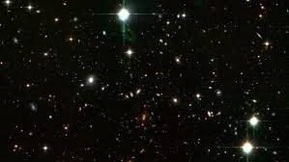
Responsibilities and the Law of Gravitation
planets
0.70 | 0.15 | 0.73 | 0.40 | 0.15 | 0.80 | 0.05 | 0.05
0.20 | 0.80 | 0.17 | 0.20 | 0.80 | 0.10 | 0.05 | 0.20
0.10 | 0.05 | 0.10 | 0.40 | 0.05 | 0.10 | 0.90 | 0.75
stars
responsibility of star i for a planet j is proportional to the pull (Newtonian law of gravitation):
Force_{i,j}=1/distance(Data_{j}, Center_{i})²
HiddenMatrix_{ij}: =
Force_{i,j} / ∑_{all centers j} Force_{i,j}

Slide 115
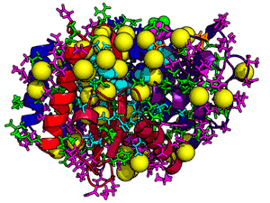
Responsibilities and Statistical Mechanics
data points
0.70 | 0.15 | 0.73 | 0.40 | 0.15 | 0.80 | 0.05 | 0.05
0.20 | 0.80 | 0.17 | 0.20 | 0.80 | 0.10 | 0.05 | 0.20
0.10 | 0.05 | 0.10 | 0.40 | 0.05 | 0.10 | 0.90 | 0.75
centers
responsibility of center i for a data point j is proportional to
Force_{i,j} = e^{-β∙distance(Dataj, Centeri)}
whereβ is a stiffness parameter.
HiddenMatrix_{ij}: =
Force_{i,j} / ∑_{all centers j} Force_{i,j}

Slide 116
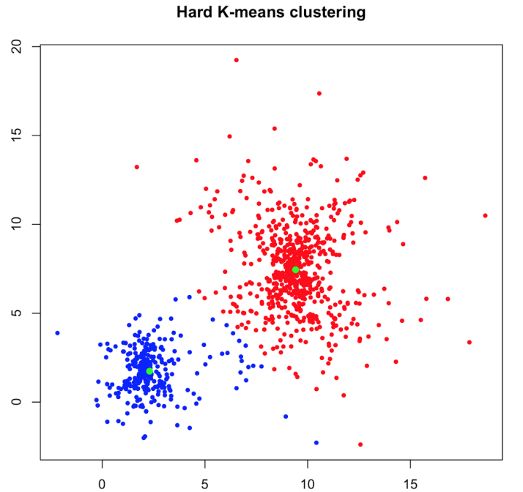
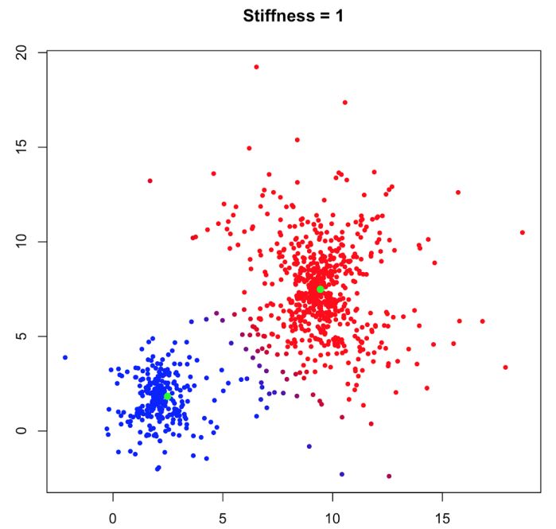
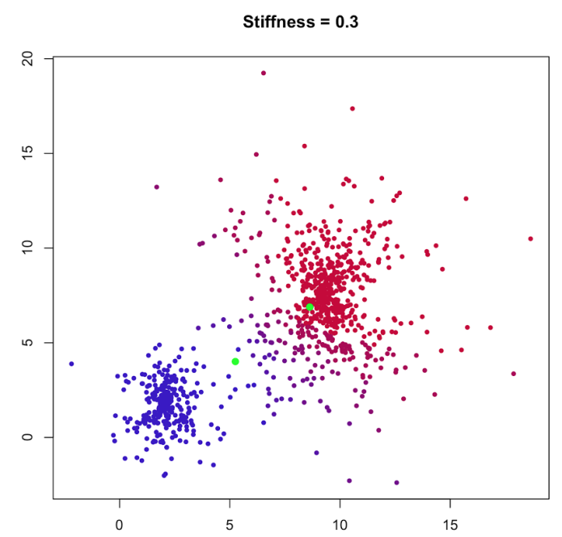
How Does Stiffness Affect Clustering?
Hard k-means clustering
Soft k-means clustering (stiffness β=1)
Soft k-means clustering (stiffness β= 0.3)

Slide 117
How Did Yeast Become a Wine Maker?
What Yeast Genes Are Responsible for Wine Brewing?
Clustering as an optimization problem
The Lloyd algorithm for k-means clustering
From Hard to Soft Clustering
From Coin Flipping to k-means Clustering
Expectation Maximization
Soft k-means Clustering
Hierarchical Clustering

Slide 118
Stratification of Clusters
Clusters often have subclusters, which have subsubclusters, and so on.

Slide 119
Stratification of Clusters
Clusters often have subclusters, which have subsubclusters, and so on.

Slide 120
Stratification of Clusters
Clusters often have subclusters, which have subsubclusters, and so on.

Slide 121
Stratification of Clusters
Clusters often have subclusters, which have sub-subclusters, and so on.

Slide 122
From Data to a Tree
To capture stratification, the hierarchical clustering algorithm organizes n data points into a tree.

Slide 123
From a Tree to a Partition into 4 Clusters
To capture stratification, the hierarchical clustering algorithm organizes n data points into a tree.
Line
crossing
the tree
at 4 points

Slide 124
From a Tree to a Partition into 4 Clusters
To capture stratification, the hierarchical clustering algorithm first organizes n data points into a tree.
Line
crossing
the tree
at 4 points
4 Clusters

Slide 125
From a Tree to a Partition into 6 Clusters
To capture stratification, the hierarchical clustering algorithm first organizes n data points into a tree.
Line
crossing
the tree
at 6 points
6 Clusters

Slide 126
Constructing the Tree
Hierarchical clustering starts from a transformation of n x m expression matrix into n x n similarity matrix or distance matrix.
E.g., the similarity between expression vectors can be defined as their dot product or Pearson correlation coefficient.

Slide 127
Constructing the Tree
Hierarchical clustering starts from a transformation of n x m expression matrix into n x n similarity matrix or distance matrix.
Distance Matrix

Slide 128
Constructing the Tree
form a node (single-element cluster) for every gene
Distance Matrix
g₃
g₅
g₈
g₇
g₁
g₆
g₁₀
g₂
g₄
g₉

Slide 129
Constructing the Tree
Distance Matrix

Slide 130
Constructing the Tree
Identify the two closest clusters and merge them.
{g₃, g₅}
g₃
g₅
g₈
g₇
g₁
g₆
g₁₀
g₂
g₄
g₉

Slide 131
Constructing the Tree
Recompute the distance between two clusters as average distance between elements in the cluster.
{g₃, g₅}
g₃
g₅
g₈
g₇
g₁
g₆
g₁₀
g₂
g₄
g₉

Slide 132
Constructing the Tree
Identify the two closest clusters and merge them.
{g₂, g₄}
{g₃, g₅}
g₃
g₅
g₈
g₇
g₁
g₆
g₁₀
g₂
g₄
g₉

Slide 133
Constructing the Tree
Recompute the distance between two clusters (as average distance between elements in the cluster).
{g₂, g₄}
{g₃, g₅}
g₃
g₅
g₈
g₇
g₁
g₆
g₁₀
g₂
g₄
g₉

Slide 134
Constructing the Tree
Identify the two closest clusters and merge them.
{g₃, g₅, g₈}
{g₂, g₄}
g₃
g₅
g₈
g₇
g₁
g₆
g₁₀
g₂
g₄
g₉

Slide 135
Constructing the Tree
Iterate until all elements form a single cluster (root).

Slide 136
Constructing a Tree from a Distance Matrix D
HierarchicalClustering (D, n)
Clusters ← n single-element clusters labeled 1 to n
T ← a graph with the n isolated nodes labeled 1 to n
while there is more than one cluster
find the two closest clusters C_{i} and C_{j}
merge C_{i} and C_{j} into a new cluster C_{new} with |C_{i}| + |C_{j}| elements
add a new node labeled by cluster C_{new} to T
connect node C_{new} to C_{i} and C_{j} by directed edges
remove the rows and columns of D corresponding to C_{i} and C_{j}
remove C_{i} and C_{j} from Clusters
add a row and column to D for the cluster C_{new} by computing D(C_{new} ,C) for each cluster C in Clusters
add C_{new} to Clusters
assign root in T as a node with no incoming edges
return T

Slide 137
Constructing a Tree from a Distance Matrix D
HierarchicalClustering (D, n)
Clusters ← n single-element clusters labeled 1 to n
T ← a graph with the n isolated nodes labeled 1 to n
while there is more than one cluster
find the two closest clusters C_{i} and C_{j}
merge C_{i} and C_{j} into a new cluster C_{new} with |C_{i}| + |C_{j}| elements
add a new node labeled by cluster C_{new} to T
connect node C_{new} to C_{i} and C_{j} by directed edges
remove the rows and columns of D corresponding to C_{i} and C_{j}
remove C_{i} and C_{j} from Clusters
add a row and column to D for the cluster C_{new} by computing D(C_{new} ,C) for each cluster C in Clusters
add C_{new} to Clusters
assign root in T as a node with no incoming edges
return T

Slide 138
Different Distance Functions Result in Different Trees
Average distance between elements of two clusters:
D_{avg}(C₁, C₂) = (∑ all points i and j in clusters C1 and _{C2, respectively} D_{i,j})/ (|C₁|*|C₂|)
Minimum distance between elements of two clusters:
D_{min}(C₁, C₂) = min all points i and j in clusters C1 and _{C2, respectively} D_{i,j}

Slide 139
Clusters Constructed by HierarchicalClustering
Cluster 1
Cluster 2
Cluster 3
4
4
4
2
2
2
0
0
0
-2
-2
-2
-4
-4
-4
Cluster 4
Cluster 5
Cluster 6
4
4
4
2
2
2
0
0
0
-2
-2
-2
-4
-4
-4

Slide 140
Clusters Constructed by HierarchicalClustering
Cluster 1
Cluster 2
Cluster 3
4
4
4
2
2
2
0
0
0
-2
Surge in expression at final checkpoint
-2
-2
-4
-4
-4
Cluster 4
Cluster 5
Cluster 6
4
4
4
2
2
2
0
0
0
-2
-2
-2
-4
-4
-4

Slide 141
Clustering Yeast Genes
Cluster 1
Cluster 2
Cluster 3
4
4
4
2
2
2
0
0
0
-2
-2
-2
-4
-4
-4
Cluster 4
Cluster 5
Cluster 6
4
4
4
2
2
2
0
0
0
-2
-2
-2
-4
-4
-4

Slide 142
From Gene Expression to Gene Function
Upstream regions of many genes in this cluster have the carbon source response element (CSRE) motif (CATTCATCCG).
Since yeast prefers glucose over ethanol as an energy source, genes responsible for metabolizing “less tasty” ethanol are repressed in the presence of glucose.
CSRE activates these genes when the yeast run out of glucose and starts consuming ethanol.
4
2
0
-2
-4

Slide 143
From Expression Arrays to Clinical Oncology
Prospects:
Gene expression studies revealed that breast cancer has more grades than previously thought: a possibility to add a genomic grade to traditional histological grading of tumors.
Microarrays allow doctors to distinguish between morphologically identical types of leukemia and lead to better clinical outcomes.

Slide 144
From Expression Arrays to Clinical Oncology
Concerns:
Tumor sample preparation is critical for accuracy/reproducibility of microarray data: standard procedures for tumor sampling/storage are still missing.
Bioinformatics models for classifying tumors should have extremely low false positive and false negative rates to avoid unnecessary surgeries and missing early stages of cancer.

